Slide 1
SupportPilot – AI Ticket Resolution Agent

Slide 2
Milestone 2
(Weeks 3–4) – Knowledge Retrieval & Resolution Generation
-Integrate enterprise knowledge base search.
-Implement Retrieval-Augmented Generation workflows.
-Generate automated troubleshooting responses.

Slide 3
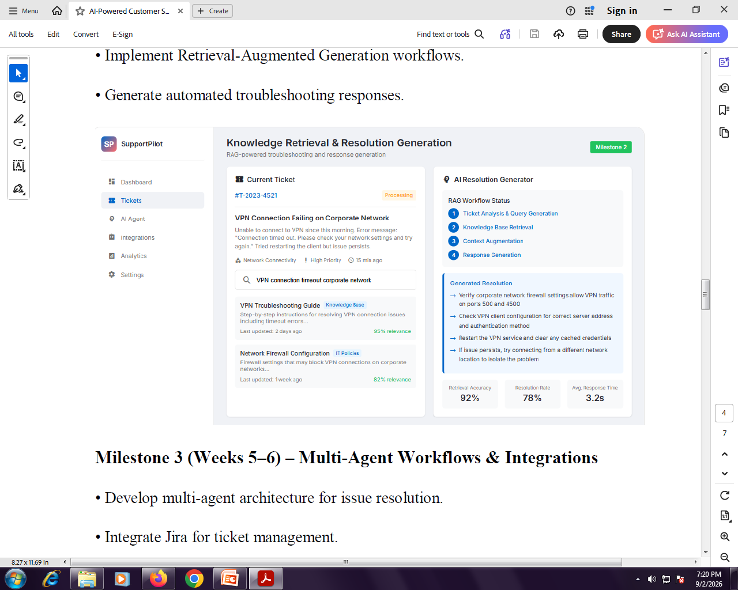

Slide 4
The goal is to take a support ticket such as:
VPN Connection Failing on Corporate Network
"Unable to connect to VPN since this morning..."
and automatically:
Analyze the ticket.
Search the enterprise knowledge base.
Retrieve the most relevant troubleshooting documents.
Add the retrieved information as context.
Ask an LLM to generate a troubleshooting resolution.
Return the response to the support agent.
This is a RAG (Retrieval-Augmented Generation) pipeline.

Slide 5
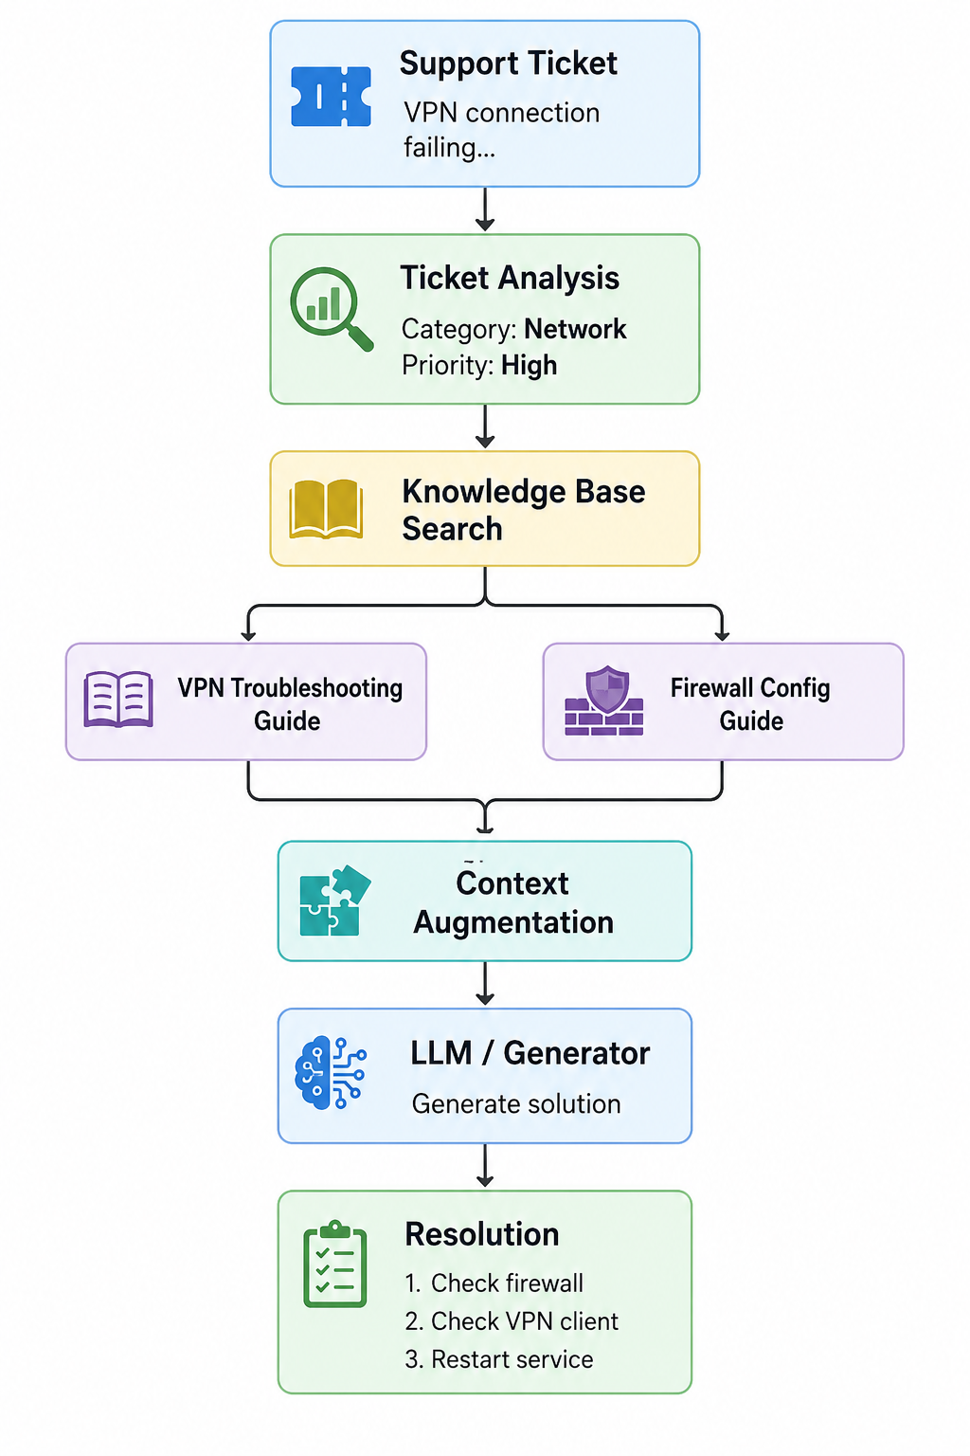
Overall Architecture

Slide 6
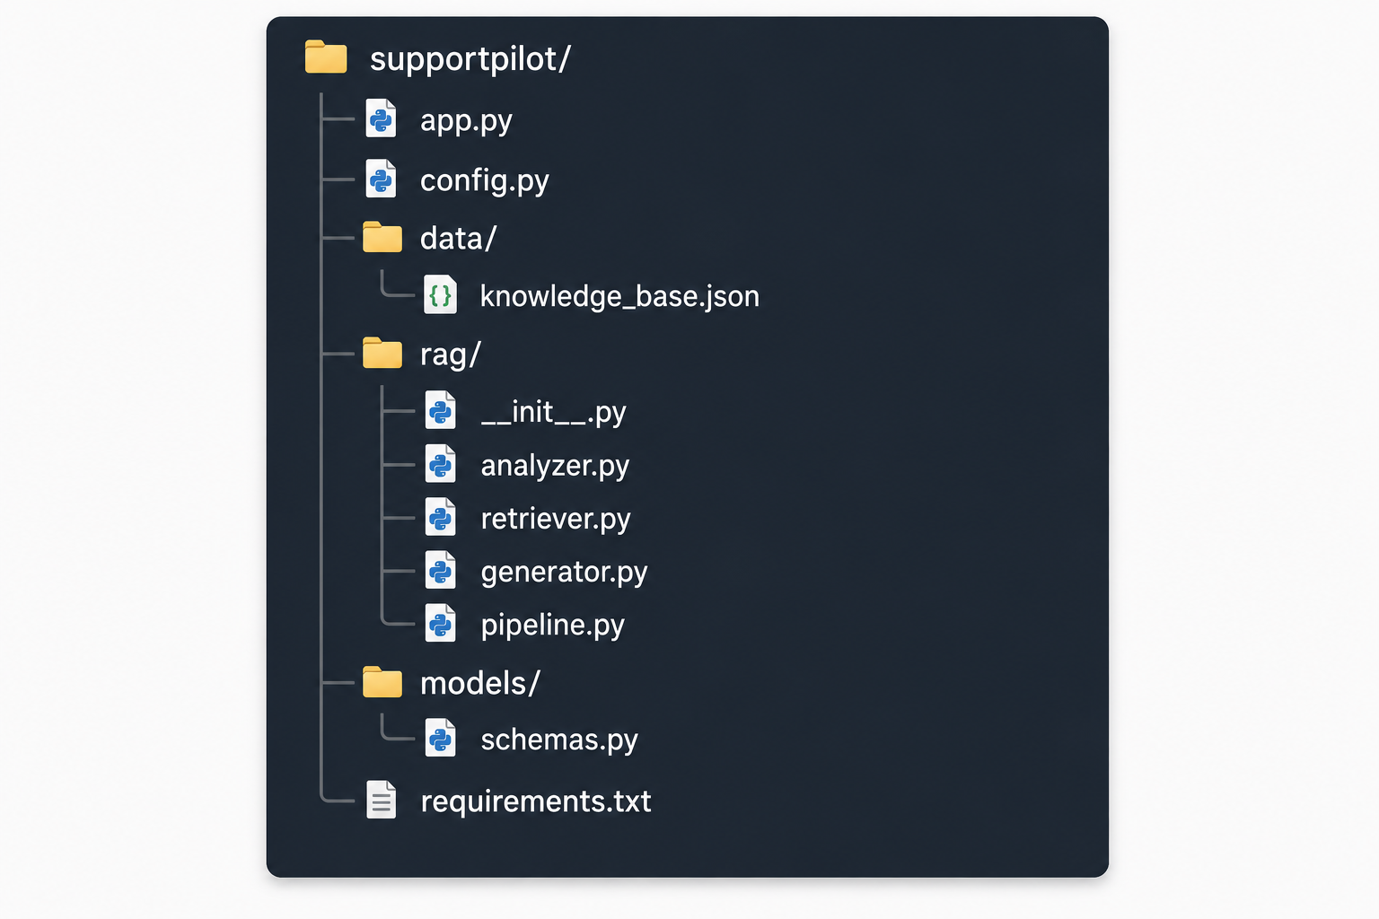
2. Recommended Python project structure

Slide 7
3. Install dependencies
For a simple local implementation:
pip install scikit-learn numpy

Slide 8
4. Enterprise Knowledge Base
The knowledge base contains documents written by the IT/support team.
For example:
knowledge_base = [
{
"id": "KB001",
"title": "VPN Troubleshooting Guide",
"category": "Network Connectivity",
"content": """
Step-by-step instructions for resolving VPN connection issues.
1. Verify that the user has an active internet connection.
2. Check VPN client configuration.
3. Verify the VPN server address.
4. Verify authentication settings.
5. Restart the VPN service.
6. Clear cached credentials if authentication fails.
"""
},

Slide 9
{
"id": "KB002",
"title": "Network Firewall Configuration",
"category": "IT Policies",
"content": """
Corporate firewalls must allow VPN traffic.
Verify that VPN traffic is permitted on the required ports,
including ports 500 and 4500 for IPsec-based VPN connections.
"""
},
{
"id": "KB003",
"title": "VPN Authentication Problems",
"category": "Authentication",
"content": """
If VPN authentication fails, verify the username, password,
MFA configuration, cached credentials, and authentication
method configured in the VPN client.
"""
}
]

Slide 10
In production, this knowledge base would normally come from sources such as:
Confluence
SharePoint
ServiceNow
Internal documentation
PDF files
Word documents
Database
IT policies
Troubleshooting manuals

Slide 11
5. Ticket analysis
The first step is to understand the ticket.
For example:
ticket = {
"id": "T-2023-4521",
"title": "VPN Connection Failing on Corporate Network",
"description": """
Unable to connect to VPN since this morning.
Error message: Connection timed out.
Please check your network settings and try again.
""",
"category": "Network Connectivity",
"priority": "High"
}

Slide 12
create a simple analyzer:
def analyze_ticket(ticket):
text = (
ticket["title"] + " " +
ticket["description"]
).lower()
keywords = []
possible_keywords = [
"vpn",
"network",
"firewall",
"authentication",
"timeout",
"connection",
"dns",
"password"
]

Slide 13
for keyword in possible_keywords:
if keyword in text:
keywords.append(keyword)
return {
"ticket_id": ticket["id"],
"category": ticket.get("category"),
"priority": ticket.get("priority"),
"keywords": keywords,
"query": text
}

Slide 14
Example:
analysis = analyze_ticket(ticket)
print(analysis)

Slide 15
Output:
{
'ticket_id': 'T-2023-4521',
'category': 'Network Connectivity',
'priority': 'High',
'keywords': [
'vpn',
'network',
'connection',
'timeout'
]
}

Slide 16
6. Knowledge-base retrieval
This is the R in RAG.
We need to find the documents most relevant to the ticket.
A simple approach is TF-IDF + cosine similarity.
Why TF-IDF?
Suppose our ticket contains:
VPN connection timeout corporate network and our documents contain:
VPN Troubleshooting Guide Network Firewall Configuration Password Reset Guide TF-IDF determines which documents contain terms that are most relevant to the query.

Slide 17
Retriever implementation
from sklearn.feature_extraction.text import TfidfVectorizer
from sklearn.metrics.pairwise import cosine_similarity
class KnowledgeRetriever:
def __init__(self, documents):
self.documents = documents
self.texts = [
doc["title"] + " " + doc["content"]
for doc in documents
]
self.vectorizer = TfidfVectorizer(
stop_words="english"
)
self.document_vectors = self.vectorizer.fit_transform(
self.texts
)

Slide 18
def search(self, query, top_k=3):
query_vector = self.vectorizer.transform([query])
scores = cosine_similarity(
query_vector,
self.document_vectors
)[0]
ranked_indices = scores.argsort()[::-1]
results = []
for index in ranked_indices[:top_k]:
results.append({
"id": self.documents[index]["id"],
"title": self.documents[index]["title"],
"category": self.documents[index]["category"],
"content": self.documents[index]["content"],
"score": float(scores[index])
})
return results

Slide 19
7. Testing the retriever
retriever = KnowledgeRetriever(knowledge_base)
results = retriever.search(
"VPN connection timeout on corporate network",
top_k=2
)
for result in results:
print(
result["title"],
result["score"]
)

Slide 20
You might get:
VPN Troubleshooting Guide 0.72 Network Firewall Configuration 0.48
This corresponds to the Knowledge Base Retrieval stage shown in your image.

Slide 21
8. Context augmentation
Now we take the retrieved documents and construct a context for the LLM.
def build_context(results):
context = ""
for result in results:
context += f"""
Knowledge Base Article:
ID: {result['id']}
Title: {result['title']}
Relevance: {result['score']:.2f}
{result['content']}
------------------------------
"""
return context

Slide 22
Example:
context = build_context(results) print(context)

Slide 23
The resulting context might look like:
Knowledge Base Article:
ID: KB001
Title: VPN Troubleshooting Guide
Relevance: 0.72
Step-by-step instructions for resolving VPN connection issues.
1. Verify internet connection.
2. Check VPN client configuration.
3. Verify VPN server address.
4. Verify authentication settings.
5. Restart VPN service.
------------------------------
Knowledge Base Article:
ID: KB002
Title: Network Firewall Configuration
Relevance: 0.48
Corporate firewalls must allow VPN traffic.
Verify that VPN traffic is permitted on ports 500 and 4500.
------------------------------

Slide 24
9. Resolution generation
Now we need an LLM to generate the actual answer.
Conceptually, we send:
SYSTEM:
You are an enterprise IT support assistant.
Use only the supplied knowledge-base information.
Do not invent troubleshooting steps.
TICKET:
VPN Connection Failing on Corporate Network
Unable to connect to VPN since this morning.
Connection timed out.
KNOWLEDGE:
[retrieved KB documents]
TASK:
Generate a concise troubleshooting resolution.

Slide 25
Before connecting an actual LLM, you can implement a mock generator.
def generate_resolution(ticket, retrieved_docs):
if not retrieved_docs:
return "No relevant knowledge-base information was found."
resolution = []
resolution.append(
"Recommended troubleshooting steps:"
)
step_number = 1
for doc in retrieved_docs:
lines = doc["content"].split("\n")
for line in lines:
line = line.strip()
if line and (
line.startswith("1.") or
line.startswith("2.") or
line.startswith("3.") or
line.startswith("4.") or
line.startswith("5.") or
line.startswith("6.")
):

Slide 26
cleaned = line.split(".", 1)[1].strip()
resolution.append(
f"{step_number}. {cleaned}"
)
step_number += 1
resolution.append(
"If the issue persists, test the VPN from another "
"network to determine whether the problem is specific "
"to the corporate network."
)
return "\n".join(resolution)

Slide 27
10. Complete RAG pipeline
Now we combine everything.
def run_rag_pipeline(ticket, retriever):
# Step 1: Analyze ticket
analysis = analyze_ticket(ticket)
print("Step 1: Ticket Analysis")
print(analysis)
# Step 2: Retrieve knowledge
results = retriever.search(
analysis["query"],
top_k=3
)
print("\nStep 2: Knowledge Base Retrieval")
for result in results:
print(
f"{result['title']} "
f"(score={result['score']:.2f})"
)

Slide 28
# Step 3: Context augmentation
context = build_context(results)
print("\nStep 3: Context Augmentation")
print(context)
# Step 4: Generate resolution
resolution = generate_resolution(
ticket,
results
)
print("\nStep 4: Resolution Generation")
print(resolution)
return {
"ticket": ticket,
"analysis": analysis,
"retrieved_documents": results,
"context": context,
"resolution": resolution
}

Slide 29
Run it:
result = run_rag_pipeline(
ticket,
retriever
)

Slide 30
11. Complete working example
from sklearn.feature_extraction.text import TfidfVectorizer
from sklearn.metrics.pairwise import cosine_similarity
# ---------------------------------------
# 1. KNOWLEDGE BASE
# ---------------------------------------
knowledge_base = [
{
"id": "KB001",
"title": "VPN Troubleshooting Guide",
"category": "Network Connectivity",
"content": """
Step-by-step instructions for resolving VPN connection issues.
1. Verify that the user has an active internet connection.
2. Check VPN client configuration.
3. Verify the VPN server address.
4. Verify authentication settings.
5. Restart the VPN service.
6. Clear cached credentials if authentication fails.
"""
},

Slide 31
{
"id": "KB002",
"title": "Network Firewall Configuration",
"category": "IT Policies",
"content": """
Corporate firewalls must allow VPN traffic.
Verify that VPN traffic is permitted on ports
500 and 4500 for IPsec-based VPN connections.
"""
},
{
"id": "KB003",
"title": "VPN Authentication Problems",
"category": "Authentication",
"content": """
If VPN authentication fails, verify username,
password, MFA configuration, cached credentials,
and the authentication method configured
in the VPN client.
"""
}
]

Slide 32
# ---------------------------------------
# 2. TICKET
# ---------------------------------------
ticket = {
"id": "T-2023-4521",
"title": "VPN Connection Failing on Corporate Network",
"description": """
Unable to connect to VPN since this morning.
Error message: Connection timed out.
Please check your network settings and try again.
""",
"category": "Network Connectivity",
"priority": "High"
}

Slide 33
# ---------------------------------------
# 3. TICKET ANALYSIS
# ---------------------------------------
def analyze_ticket(ticket):
text = (
ticket["title"] + " " +
ticket["description"]
).lower()
keywords = []
for keyword in [
"vpn",
"network",
"firewall",
"authentication",
"timeout",
"connection"
]:
if keyword in text:
keywords.append(keyword)
return {
"ticket_id": ticket["id"],
"category": ticket["category"],
"priority": ticket["priority"],
"keywords": keywords,
"query": text
}

Slide 34
# ---------------------------------------
# 4. RETRIEVER
# ---------------------------------------
class KnowledgeRetriever:
def __init__(self, documents):
self.documents = documents
texts = [
doc["title"] + " " + doc["content"]
for doc in documents
]
self.vectorizer = TfidfVectorizer(
stop_words="english"
)
self.vectors = self.vectorizer.fit_transform(texts)
def search(self, query, top_k=3):
query_vector = self.vectorizer.transform(
[query]
)
scores = cosine_similarity(
query_vector,
self.vectors
)[0]
ranked = scores.argsort()[::-1]
results = []
for i in ranked[:top_k]:
results.append({
**self.documents[i],
"score": float(scores[i])
})
return results

Slide 35
# ---------------------------------------
# 5. CONTEXT AUGMENTATION
# ---------------------------------------
def build_context(results):
context = ""
for doc in results:
context += f"""
SOURCE: {doc['id']}
TITLE: {doc['title']}
RELEVANCE: {doc['score']:.2f}
{doc['content']}
=============================
"""
return context

Slide 36
# ---------------------------------------
# 6. RESOLUTION GENERATOR
# ---------------------------------------
def generate_resolution(ticket, documents):
resolution = [
"Recommended Resolution:"
]
resolution.append(
"1. Verify that the corporate network has "
"an active internet connection."
)
resolution.append(
"2. Verify the VPN client configuration "
"and VPN server address."
)
resolution.append(
"3. Verify that the corporate firewall "
"allows VPN traffic on ports 500 and 4500."
)
resolution.append(
"4. Verify VPN authentication settings."
)
resolution.append(
"5. Restart the VPN service and retry the connection."
)
resolution.append(
"6. If the problem persists, test from another "
"network to isolate whether the corporate network "
"is causing the failure."
)
return "\n".join(resolution)

Slide 37
# ---------------------------------------
# 7. RAG PIPELINE
# ---------------------------------------
def run_pipeline(ticket):
print("=" * 60)
print("AI RESOLUTION GENERATOR")
print("=" * 60)
# Ticket analysis
analysis = analyze_ticket(ticket)
print("\n[1] Ticket Analysis")
print(analysis)

Slide 38
# Retrieval
retriever = KnowledgeRetriever(
knowledge_base
)
results = retriever.search(
analysis["query"],
top_k=3
)
print("\n[2] Knowledge Base Retrieval")
for doc in results:
print(
f"- {doc['title']} "
f"(relevance={doc['score']:.2f})"
)
# Context
context = build_context(results)
print("\n[3] Context Augmentation")
print(context)

Slide 39
# Generation
resolution = generate_resolution(
ticket,
results
)
print("\n[4] Resolution Generation")
print(resolution)
return {
"analysis": analysis,
"documents": results,
"resolution": resolution
}
# ---------------------------------------
# 8. RUN
# ---------------------------------------
if __name__ == "__main__":
output = run_pipeline(ticket)

Slide 40
12. Connecting a real LLM
The mock generate_resolution() should eventually be replaced with an LLM.
The important point is that the LLM should not simply answer the ticket from its own knowledge.
Instead:
Ticket
↓
Retriever
↓
Relevant KB articles
↓
Context
↓
LLM
↓
Resolution

Slide 41
For example, your prompt can be:
def create_prompt(ticket, context):
return f"""
You are an enterprise IT support assistant.
Your task is to troubleshoot the following support ticket.
TICKET
------
Title:
{ticket['title']}
Description:
{ticket['description']}
Priority:
{ticket['priority']}
KNOWLEDGE BASE
--------------
{context}
INSTRUCTIONS
------------
1. Use the knowledge base as the primary source.
2. Do not invent company-specific policies.
3. Provide numbered troubleshooting steps.
4. Explain the likely cause when possible.
5. If the knowledge base does not contain enough information,
clearly state that additional investigation is required.
6. Keep the response concise and suitable for a support agent.
Generate the recommended resolution.
"""

Slide 42
This is a much better architecture than:
prompt = ticket_description llm.generate(prompt)
because the model receives enterprise-specific information.

Slide 43
13. Improving retrieval with embeddings
TF-IDF is excellent for your initial milestone because it is easy to understand and deploy.
However, production RAG normally uses semantic embeddings.
For example:
Ticket:
"VPN won't connect and keeps timing out"
Knowledge article:
"Troubleshooting IPsec connectivity failures"

Slide 44
An embedding model converts text into vectors:
Ticket
↓
Embedding Model
↓
[0.21, 0.73, 0.11, ...]
KB Article
↓
Embedding Model
↓
[0.19, 0.71, 0.15, ...]

Slide 45
Then calculate:
cosine_similarity(ticket_vector, document_vector)
This provides semantic retrieval.

Slide 46
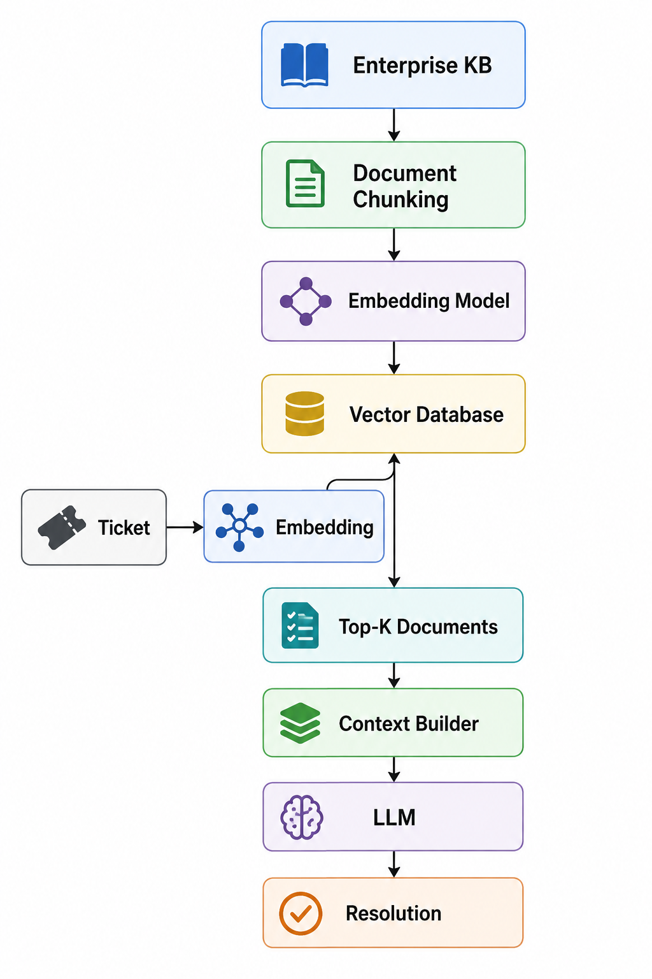
A production architecture would therefore be:

Slide 47
14. Important production feature: citations
Your generated resolution should ideally tell the agent where the answer came from.
Instead of:
Check the firewall.
Restart the VPN service.

Slide 48
return:
Recommended Resolution
1. Verify that VPN traffic is allowed through the
corporate firewall.
Source: KB002 – Network Firewall Configuration
2. Verify VPN client configuration and server address.
Source: KB001 – VPN Troubleshooting Guide
3. Restart the VPN service.
Source: KB001 – VPN Troubleshooting Guide

Slide 49
15. Confidence/relevance threshold
Don't blindly pass every document to the LLM.
For example:
MIN_RELEVANCE = 0.30
results = [
result
for result in results
if result["score"] >= MIN_RELEVANCE
]

Slide 50
Then:
if not results:
return {
"status": "INSUFFICIENT_KNOWLEDGE",
"message": (
"No sufficiently relevant knowledge-base "
"articles were found."
)
}

Slide 51
16. RAG workflow status
Your UI shows:
RAG Workflow Status
1. Ticket Analysis & Query Generation
2. Knowledge Base Retrieval
3. Context Augmentation
4. Response Generation

Slide 52
You can represent that in Python:
workflow = {
"ticket_analysis": "completed",
"knowledge_retrieval": "completed",
"context_augmentation": "completed",
"response_generation": "completed"
}

Slide 53
Or dynamically:
def update_status(stage, status):
print(
f"[{stage}] {status}"
)

Slide 54
Then:
update_status(
"Ticket Analysis",
"completed"
)
update_status(
"Knowledge Retrieval",
"completed"
)
update_status(
"Context Augmentation",
"completed"
)
update_status(
"Response Generation",
"completed"
)

Slide 55
17. Metrics shown in the UI
Your screenshot also shows:
Retrieval Accuracy 92%
Resolution Rate 78% Avg.
Response Time 3.2s
These should be treated as system metrics, not hard-coded values.

Slide 56
For example:
metrics = {
"retrieval_accuracy": 0.92,
"resolution_rate": 0.78,
"average_response_time": 3.2
}

Slide 57
Retrieval accuracy
For example:
100 tickets tested
92 retrieved the correct KB article
Accuracy = 92 / 100 = 92%

Slide 58
Resolution rate
100 AI-generated resolutions
78 resolved the issue without escalation
Resolution Rate = 78%

Slide 59
Average response time
average_time = sum(response_times) / len(response_times)

